Slide 1
Efficient Algorithms for Generalized Subgraph Query Processing
Wenqing Lin, Xiaokui Xiao, James Cheng, and Sourav S. Bhowmick
Nanyang Technological University, Singapore

Slide 2
Outline
Motivation and Background
Problem Statement
Indexing Techniques
Distance Index
Frequent Pattern Index
Star Index
Experiments
Conclusions

Slide 3
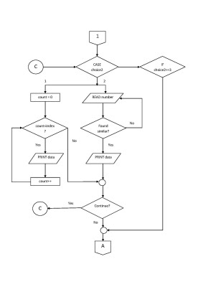
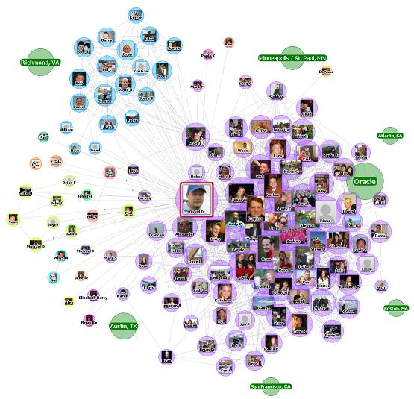
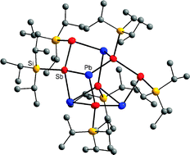
Motivation and Background
Graph is a powerful data model
Graph data is ubiquitous

Slide 4
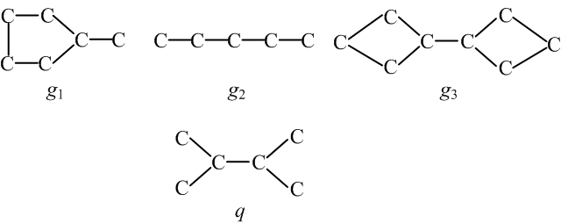
Preliminary
Subgraph Query
Given a graph database $D$ and a graph query $q$
Find all graphs $g$ in $D$ s.t. $q$ is a subgraph of $g$

Slide 5
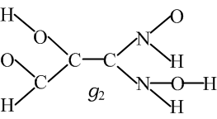
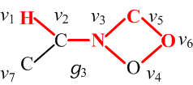
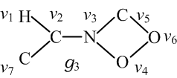
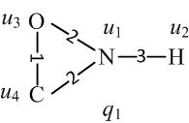
Generalized Subgraph Query
Three data graphs
^{POINT N ;}
^{POINT H ;}
^{POINT O ;}
^{POINT C ;}
^{DISTANCE (1, 2) 1 3 ;}
^{DISTANCE (1, 3) 1 2 ;}
^{DISTANCE (1, 4) 1 2 ;}
^{DISTANCE (3, 4) 1 1 ;}
$q_{1}$ is a generalized subgraph of $g_{3}$
A query in ALADDIN language
Query graph
Query Answer
Compared to subgraph query, generalized subgraph query allows an edge in the query graph mapping to a path in a data graph

Slide 6
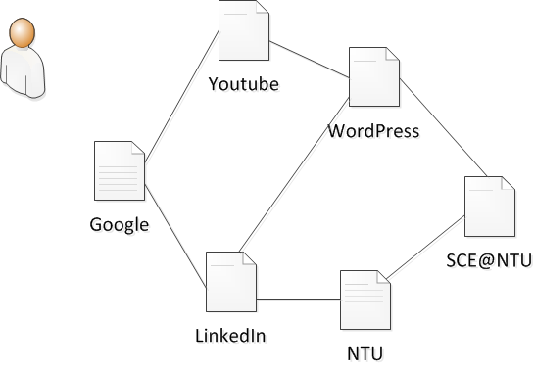
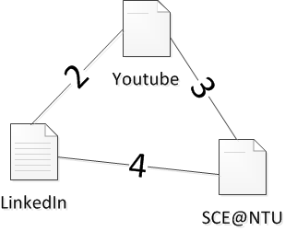
More Applications
Querying user online traversal graphs
Searching pictures in an image database
Drug design, motif discovery …

Slide 7
Challenges
It involves subgraph isomorphism which is NP-hard
The relaxation in the new query from exact edge matching to approximate path matching further explodes the already exponential search space
Existing pruning techniques cannot be directly applied or are simply not adequate
Notes:
(feature $f$ is different, and mapping graph to generalized graph is a new problem.)

Slide 8
Outline
Motivation and Background
Problem Statement
Indexing Techniques
Distance Index
Frequent Pattern Index
Star Index
Experiments
Conclusions

Slide 9
Distance Index
Distance triplet: $(l_{1}, l_{2},d)$
Use label order to reduce duplicate distance triplets
O<N<H<C
$$(l_{1}, l_{2},d)$$
(C, C, 1)
(C, C, 2)
(C, C, 3)
……
(N, H, 2)
(O, C, 1)
(O, C, 2)
……
$$(l_{1}, l_{2},d)$$
(C, C, 1)
……
(N, H, 2)
(O, C, 1)
……

Slide 10
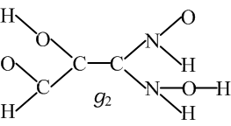
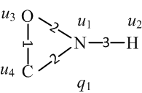
Distance Index
$$(l_{1}, l_{2},d)$$
(C, C, 1)
……
(N, H, 1)
(N, H, 2)
(O, C, 1)
……
$$\{g_{1},g_{2},g_{3}\}$$
……
$$\{g_{2}\}$$
$$\{g_{1}, g_{3}\}$$
$$\{g_{2},g_{3}\}$$
……
$$\{g_{1}, g_{2},g_{3}\}$$
$$C$$
$$\{g_{2},g_{3}\}$$
……
Need $O\left({\overline{|V|}}^{2}\left|G\right|\right)$ space and $O\left(\overline{\left|V\right|}\overline{\left|E\right|}\left|G\right|\right)$ construction time

Slide 11
Outline
Motivation and Background
Problem Statement
Indexing Techniques
Distance Index
Frequent Pattern Index
Star Index
Experiments
Conclusions

Slide 12
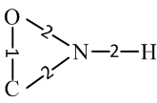
Frequent Pattern Index
Maximum edge weight $ρ$= 3
Frequency threshold $σ=0.2$
Maximum size $s=4$
$$\{g_{2},g_{3}\}$$
$$\{{g_{1},g}_{2},g_{3}\}$$
$$\{g_{3}\}$$
$$\{g_{3}\}$$
^{Edge index:}
……

Slide 13
Frequent Pattern Index
Maximum edge weight $ρ$= 2
Frequency threshold $σ=0.2$
Maximum size $s=4$
$$\{g_{2},g_{3}\}$$
$$\{{g_{1},g}_{2},g_{3}\}$$
2
$$\{g_{3}\}$$
$$\{g_{2},g_{3}\}$$
^{Edge index:}
^{(N, H, 3)}
…….
$$\{{g_{1},g}_{2},g_{3}\}$$
$$A=\{g_{3}\}$$

Slide 14
Outline
Motivation and Background
Problem Statement
Indexing Techniques
Distance Index
Frequent Pattern Index
Star Index
Experiments
Conclusions

Slide 15
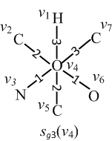
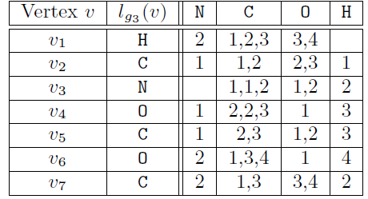
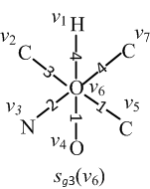
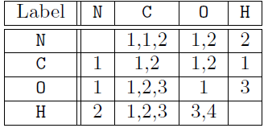
Star Index

Slide 16
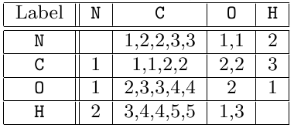
Star Index
root
N
C
O
H
……
N
C
O
H
……
……
1
1
1,2
2,2
1
3
$$\{g_{1},g_{3}\}$$
$$\{g_{3}\}$$
$$\{g_{1}\}$$
$$\{g_{3}\}$$
$$\{g_{1}\}$$
1,2,2
2
$$\{g_{1}\}$$
$$\{g_{3}\}$$

Slide 17
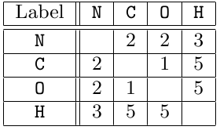
Star Index
root
N
C
O
H
……
N
C
O
H
……
……
1
1
1,2
2,2
1
3
$$\{g_{1},g_{3}\}$$
$$\{g_{3}\}$$
$$\{g_{1}\}$$
$$\{g_{3}\}$$
$$\{g_{1}\}$$
1,2,2
2
$$\{g_{1}\}$$
$$\{g_{3}\}$$
$$\{g_{1},g_{3}\}$$
Space complexity:
Query complexity:
$$C=\{g_{3}\}$$

Slide 18
Summary
Distance Index
Feature: distance triplets
Lose the structural information of data graphs
Frequent Pattern Index
Feature: frequent generalized subgraphs, and distance triplets
Expensive construction cost
Star Index
Feature: star graph
A good balance between query processing and space overhead

Slide 19
Experiments
Experiment settings for indexing experiments
Datasets: PubChem (up to 100K graphs)
Query sets: generalized subgraphs extracting from each dataset in which at most 10% data graphs match the query graph

Slide 20
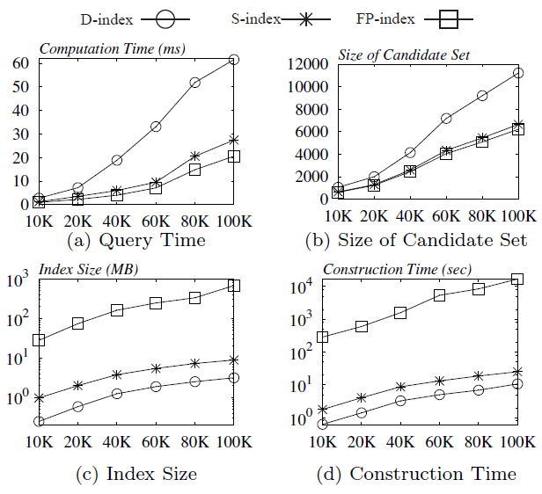
Index Performance v.s. Dataset Size

Slide 21
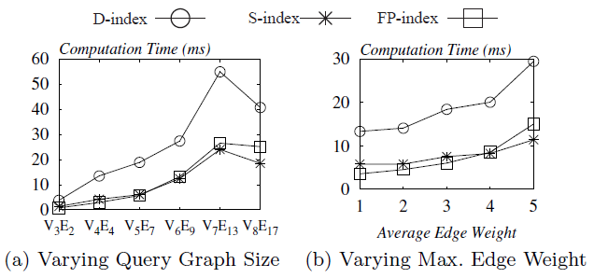
Vary Parameters of the Query Graphs

Slide 22
Conclusions
A new type of graph queries: generalized subgraph queries
Three indexes
Distance Index: entailing relatively high query cost but minimal space and preprocessing overhead
Frequent Pattern Index: superior query performance at the cost of space and pre-computation time
Star Index: achieving both a low index construction cost and a short query response time

Slide 23
Mahalo! Thank you!

